Slide 1
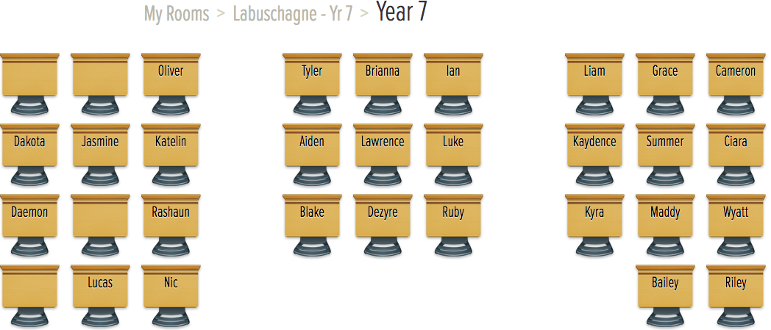

Slide 2
We are setting up a NEW section of your interactive notebooks for the next topic!
From your last page of the measurement notebook skip one page and we will set up the new notebook.
You will have the page numbers start over again!

Slide 3


My Money Interactive Notebook
Name
Class
Teacher
Term 1 Semester 1
1

Slide 4
Contents
Glossary or Formula Page
Page
Date
Description
2
3

Slide 5
Estimating
Year 7
Week 9
Lesson 2

Slide 6
Mental Math
(Do this on your task side of your book)
Write the definition of probability.
If a six-sided die is thrown, what is the probability of throwing an even number?
50 – 14 =
60 x 3 =
23 + 7 =
The chance of an event happening
3/6 = 1/2
36
130
30

Slide 7

24
7
30
Topic: Estimating
Date
EQ – How do we estimate numbers?
To roughly calculate the value, number or quantity of something
An estimate of how much we have to pay is useful
What is estimation?

Slide 8
24
7
30
Topic: Estimating
Date
EQ – How do we estimate numbers?
What is leading digit estimation?
What is a leading digit?
Rounding to the first digit gives a fairly rough estimate of what something might cost
The leading digit is the first digit in the number given
Example: 367 (the 3 is the leading digit)

Slide 9
24
7
30
Topic: Estimating
Date
EQ – How do we estimate numbers?
Step 1: Find the leading digit and underline it
264
How to round to the leading digit?
Step 2: Find the digit to the left of the leading digit and circle it
264
Step 3: If the number that you have circled is less than 5 then leave the leading digit as it is and replace all the other numbers with zeros
If the number that you have circled is 5 or more than 5 then add 1 to the leading digit and replace all the other numbers with zeros

Slide 10
Examples
264 =
459 =
7,208 =
5,790 =
300
500
7,000
6,000
Notes:
• Give students the opportunity to practise with teacher guidance
• Provide immediate and specific feedback with knowledge of results

Slide 11
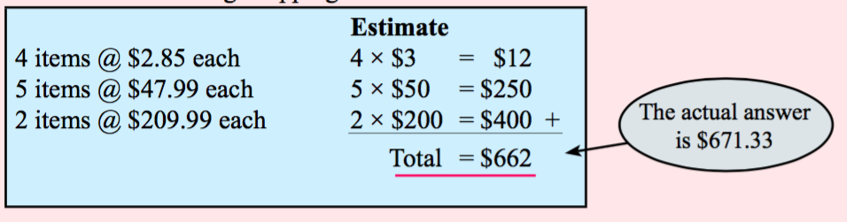
Examples
Use round to the first/leading digit to estimate the following shopping bill:
Notes:
• Give students the opportunity to practise with teacher guidance
• Provide immediate and specific feedback with knowledge of results

Slide 12
Task
Page 50
Exercise 4.1
Questions 1-10
Notes:
• Give students the opportunity to practise with teacher guidance
• Provide immediate and specific feedback with knowledge of results

